Slide 1
Web Development
Module 2, Lesson 4:
Building a Web Server with Express

Slide 2
Topics
Web Content
Node
Express
Middleware

Slide 3
Objectives
By the end of this lesson you should be able to:
Understand the difference between static and dynamic content
Use Node’s middleware
Run Express

Slide 4
Web App Architectures
Main approaches to building web apps
Thick server: Server-side rendering and no client code
Server-side rendering and bits of JavaScript on the client
Thick client: Browser-side rendering typically as a single-page applications (SPAs) and RESTful API on the server
Isomorphic/universal apps: thick client with reusing client code on the server-side for rendering, routes, data caching, etc.
Notes:
Notes:
Thick servers: 1990-2000; almost not used today except when performance really maters, in this case the pages generated ahead of time and stored as plain HTML files. Examples: HTML files on Apache http server or nginx, Wintersmith or Jekyll. Advantages: easy to maintain, fast and SEO friendly. Disadvantage: terrible user experience because a user has to wait for all page to reload; large bandwidth.
Mostly server-side rendering with client JS to format, add some interactivity/logic. Examples: WordPress. Advantages: still easy to implement and maintain, and SEO friendly. Disadvantage: terrible user experience (but somewhat better than thick server); large bandwidth.
Thick client: Most popular approach for great UX. 100% rendering and most of the logic happens in the browser. 2002-2016+. Examples: Gmail, Gdocs, OneDrive, YouTube. Advantages: great UX, almost like desktop apps. In fact, companies started to use this approach to build desktop apps with Electron or NodeKit (Node-based projects), e.g., Slack, Atom. Small bandwidth. Disadvantages: harder to maintain because you need to duplicate some code and logic on the server (templates, validation, routes). No SEO, that’s why this approach is often used for restricted access apps like Gmail where you don’t need SEO.
This is the best approach so far. By sharing code between client and browser we can get the same great UX and low bandwidth as with thick client without the troubles of duplicating code for the server. We can also increase performance by pre-loading data or rendering the first page load on the server.

Slide 5

Thick Client Architecture
Browser
Server
2
Static Assets
1
Static Assets
Request
4
User
Assets
3
SPA Code
5
6
App Logic
Data
Rendering
Data Request
&
Response
Input & UI
Data Service
7
8
User Interface
Notes:
Notes:
User sends a request
Browser sends a request to the server
Server responds with static assets such as HTML (skeleton, that is without main data), CSS, JavaScript
Browser renders static assets. At this step the user typically sees “Loading…” or a spinner because there’s not actual data, just the skeleton structure
Browser JavaScript SPA code executes a request to the server to gets the data (typically based on the URL). Server sends back JSON or XML data, not HTML
SPA code in the browser renders full HTML by combining templates and data
User see web page with data (Loading… is gone)
User submits another request or interacts, this might trigger 1-7 again or just 5-7.
We will be using this approach and implement Node server and React SPA client

Slide 6
Web Content
Types of web content
Static
Dynamic
Node’s non-blocking I/O is excellent at dynamic generation
Notes:
Notes:
Talk about static (HTML files) and dynamic content (apps that generate HTML).
Static content:
Inclusive of things like image files, static html files that are already put together, and other related content that is stored on some style of drive storage and available for immediate return to a requestor via general response.
Dynamic content:
The content that is put together - or generated - by code pulling together data from data sources or by other means, and then provided to the requestor.
Node:
For static content like image files and related content it is actually a great benefit to hand that off to server software that can handle the specific OS level request.
Node.js can absolutely handle these requests, but it is often better to offload to servers that specifically handle this static content like CDNs, OS-level call systems, or object stores.

Slide 7
The server, request, and response Objects
var http = require('http');
http.createServer(function (req, res) {
res.writeHead(200, {'Content-Type': 'text/plain'});
res.end('Hello World\n');
}).listen(1337, '127.0.0.1');
console.log('Server running at http://127.0.0.1:1337/');
Notes:
Notes:
createServer callback is called each time there's a request.
There are no npm modules in this example.
References:
http://nodejs.org/api/http.html

Slide 8
Running the App
//Run with:
$ node server.js
//Send requests:
$ curl http://localhost:1337
//Or:
<http://localhost:1337>
Notes:
Notes:
Demo running the app

Slide 9
HTTP Object and Response
HTTP object
HTTP response
Reading from an HTTP request
var server = http.createServer([requestListener])
server.listen(port[, hostname][, backlog][, callback])
response.writeHead(200, {
'Content-Length': body.length,
'Content-Type': 'text/plain' });
request.url
request.method
Notes:
Notes:
Http object:
Explain the options of createServer and listen
Http response:
Explain how to send status code and headers
Reading HTTP request:
Explain how request argument in the request handler has all the information needed
References:
https://nodejs.org/api/http.html
https://nodejs.org/api/http.html#http_class_http_server

Slide 10
How-to Example
Sample Code code/lesson4:
nodejs-app.js: Simple HTTP web server
nodejs-socket.js: Web server with sockets (not HTTP)
board-api: RESTful API written with core http module
Notes:
Notes:
Walk thru the code, show that requests must be processed manually and pay loads must be parsed in board-api because core http module won't do it on its own—that's a framework is needed!

Slide 11
Core http Module
Node’s core http module allows us to build HTTP(S) web apps
Advantages
No need to install it with npm (part of the core)
Downsides
No request body parsing
No query string parsing
No URL matching
No structure to organize code
No plugins
Notes:
Notes:
The only advantage of http is that you don’t need to install it with npm because it’s already part of Node
Downsides are that http is very rudimentary and low-level. You’ll need to implement a lot of things yourself or use modules from npm (or roll your own modules)

Slide 12
Express
Express is a web application framework for Node
Most popular web application framework for Node
Easy to work with as it ties into Node's functional paradigm:
Modularizes business logic
Renders HTML or composes APIs
Parses payload, cookies, query strings
Matches URL and HTTP methods to route definitions
Notes:
Notes:
Vast number of plugins (middleware) for: sessions, validations, data sources, security, static content, etc.
Basically, using a framework is almost always a better choice.
No need to re-invent the wheel.

Slide 13
Installing Dependency and Scaffolding
//Dependency:
$ npm install express --save
//Scaffolding:
//Install Express.js command-line generator:
$ npm install –g express-generator
Notes:
Notes:
Two separate packages. Never install dependency express globally!
Dependency:
Stress to students that they never want to install express globally (repeat it 2x if there are Java developers in the class, because they learned to install dependencies globally to save space... which sadly leads to conflicts).
Scaffolding:
Express generator is a separate module from express, but it is used with the express command.

Slide 14
Using the Generator
Generate Scaffolding
$ express todo-list-app
Generated Files and Directories | Description
app.js | main file, houses the embedded server and application logic
public/ | contains static files to be served by the embedded server
routes/ | houses custom routing for the embedded server
views/ | contains templates that can be processed by a template engine
Notes:
Notes:
Go through all aspects of the generated app and point out various features.
Specifically talk about app.js and how it abstracts away some things for testing
Make sure the students follow you along with this command

Slide 15
Configuring Express
The Express server needs to be configured before it can start
var app = express();
app.set('port', process.env.PORT || 3000);
app.set('views', 'views'); // the directory the templates are stored in
app.set('view engine', 'jade');
Notes:
Notes:
The Express server is configured through the ‘set’ method.

Slide 16
Node.js Middleware Pattern
Middleware pattern is a series of processing units connected together, where the output of one unit is the input for the next one.
function(args, next) {
next(output) // error or real output
}
Notes:
Notes:
In Node.js, this often means a series of functions.

Slide 17
Creating and Ordering Middleware
Custom middleware is easy to create
Middleware is executed in the order specified
//Create:
app.use(function (req, res, next) {
// modify req or res
// execute the callback when done
next()
})
//Order:
let logger = require(‘morgan’)
let bodyParser = require(‘body-parser’)
app.use(logger('dev'))
app.use(bodyParser.json())
Notes:
Notes:
In Express, we use app.use to apply a middleware (function). Express implements the middleware manager for us so all we need to do is to define a middleware or use a middleware from an npm module (body-parser, morgan).

Slide 18
Connecting Middleware
app.use(function middleware1(req, res, next) {
// middleware 1
next();
});
app.use(function middleware2(req, res, next) {
// middleware 2
next();
});
Notes:
Notes:
The order in which you define middleware will dictate the order in which they will be executed during the lifecycle of the incoming HTTP(S) request

Slide 19
Connect Framework
Express leverages the Connect framework to provide middleware functionality.
Middleware is used to manage how a request should be handled.
Notes:
Notes:
Basically, using a framework is almost always a better choice even something lightweight as Express or Connect.
You can tap into vast ecosystem of open-source plugins (middleware). They’ll do almost everything for you: parsing, file uploads, request data validation, sessions, OAuth.

Slide 20
Connect/Express Middleware
Most Popular and Useful
$ npm install <package_name> --save
Package Name | Description
body-parser | Request payload
compression | gzip
connect-timeout | Set request timeout
cookie-parser | Cookies
cookie-session | Session via Cookies store
Notes:
References:
body-parser: https://github.com/expressjs/body-parser
Compression: https://github.com/expressjs/compression
connect-timeout: https://github.com/expressjs/timeout
cookie-parser: https://github.com/expressjs/cookie-parser
cookie-session: https://github.com/expressjs/cookie-session

Slide 21
Connect/Express Middleware
Package Name | Description
csurf | CSRF
errorhandler | Error handler
express-session | Session via in-memory or other store
method-override | HTTP method override
morgan | Server logs
response-time | Records request response time
serve-favicon | Serves a favicon
serve-index | Serves directory listings for a given path
serve-static | Static content
vhost | Hands off request to handle based on host
Notes:
Notes:
A favicon is a visual cue that client software like browsers use to identify a site.
References:
csurf: https://github.com/expressjs/csurf
errorhandler: https://github.com/expressjs/errorhandler
express-session: https://github.com/expressjs/session
method-override: https://github.com/expressjs/method-override
morgan: https://github.com/expressjs/morgan
response-time: https://github.com/expressjs/response-time
serve-favicon: https://github.com/expressjs/serve-favicon
serve-index: https://github.com/expressjs/serve-index
serve-static: https://github.com/expressjs/serve-static
vhost: https://github.com/expressjs/vhost

Slide 22
Other Popular Middleware
Package Name | Description
cookies keygrip | Analogous to cookie-parser
raw-body | Get and validate raw body of a stream
connect-multiparty connect-busboy | Connect middleware
qs | Analogous to query
st connect-static | Analogous to staticCache
express-validator | validation
less | LESS CSS
passport | Authentication library
helmet | Security headers
connect-cors | CORS
connect-redis | Redis session store for Connect
Notes:
Notes:
More info in the Express cheatsheet https://github.com/azat-co/cheatsheets/tree/master/express4

Slide 23
Template Engine
Setting the view engine variable to jade (for example) would trigger the function call internally
Custom callbacks can be defined to parse templates
app.set('view engine', 'jade'); // shorthand
// does the same as the above
app.engine('jade', require('jade').__express);
app.engine([format], function (path, options, callback) {
// template parsing logic goes here
});
Notes:
Notes:
The value of view engine is the npm module name of the library that you want to use.
It’s also the extension of the files in your “views” folder.
Custom callbacks are useful if the template engine doesn't export an **__express** function
This is a good post on Jade and Handlebars in Express from Practical Node http://webapplog.com/jade-handlebars-express/

Slide 24
Express Routes
//Home Page:
app.get('/', function(req, res){
res.send('Hello World')[
});
//Catch all wild card:
app.get('*', function(req, res){
res.send('Hello World')[
});
Notes:
Notes:
Creating a simple GET route for root (/) and for all URLs.
Highlight that * should not be placed in the beginning or nothing will be executed after this route.

Slide 25
Home Page
app.get('/', function(req, res, next) {
// authorize the request
req.auth = true
next()
}, function(req, res){
res.send('Hello World')[
});
Notes:
Notes:
Middleware and request handler are very similar.
They use the same signatures.
In request handlers next() is optional if it's the last request handler for the route
Middleware must have a finish or provide a response; without, this the request will never end and eventually timeout.
This is a good post on URL parameters and routing in Express: http://webapplog.com/url-parameters-and-routing-in-express-js/

Slide 26
Error Handling
app.get('/', function(req, res, next) {
next(new Error(‘ooops’))
})
app.use(function(error, request, response, next){
response.status(500).send({error: ‘We had an error’})
})
Notes:
Notes:
Defining Error handlers is very easy. You just need to add error as the first argument in the handler
The order matters, because you can call next to pass to subsequent (down) error handlers
To call an error handler, pass an error object to next (callback) in request handler
This will stop the normal routes and middleware chain and jump to error handler(s)
This is a good post on error handling in Express: http://webapplog.com/error-handling-and-running-an-express-js-app/

Slide 27
Running HTTP Express Server
var http = require('http'),
express = require('express’)
var app = express()
// ...
var server = http.createServer(app)
server.listen(app.get('port'), function () {
// Do something... maybe log some info?
})
Notes:
Notes:
Example uses a core http module but could use app.listen directly.
https can be used as well.
To do this, load certificates and then replace http with https.
References:
http://nodejs.org/api/http.html
http://expressjs.com/en/api.html#app.listen

Slide 28
Running HTTPS Express
var https = require('https'),
express = require('express’)
var app = express()
// …
var server = https.createServer({
key: fs.readFileSync('key.pem'),
cert: fs.readFileSync('cert.pem')
}, app)
server.listen(app.get('port'), function () {
// Do something... maybe log some info?
})
Notes:
Notes:
Create or download certificate and the key
Use https instead of http by providing the key and cert
Launch the app with listen.
References:
http://nodejs.org/api/https.html
Good blog on HTTPS with Express: http://blog.mgechev.com/2014/02/19/create-https-tls-ssl-application-with-express-nodejs/

Slide 29
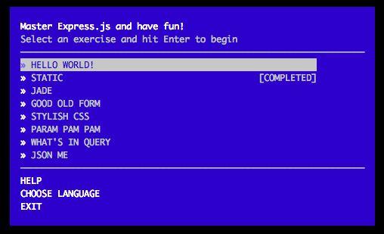
ExpressWorks Auto Workshop
Solve series of problems by building Express apps
npm i –g expressworks
expressworks
Notes:
Notes:
Select first problem
Read the problem (without hints) and
Try solving it
Use “expressworks verify name.js” and “expressworks run name.js”
Watch video with the official solution
References:
Videos: http://webapplog.com/express/
Workshop instructions: https://github.com/azat-co/expressworks

Slide 30
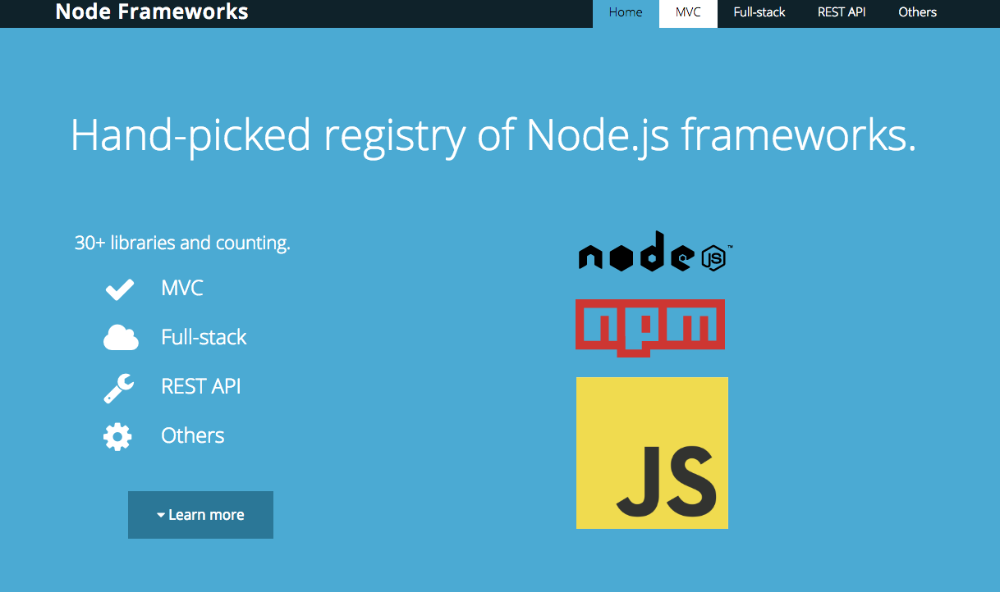
Alternatives to Express
Sails
LoopBack
Meteor
Hapi
Restify
Notes:
Notes:
There are more advanced frameworks like Sails and Loopback but they extend Express, so it's good to start learning with Express because the knowledge can be applied and reused later.
Loopback and Sails use Express and its middleware. That’s why it’s important to know Express!
Restify is a minimal framework just for RESTful APIs, no templates
Hapi is different from Express. It prefers configuration and might be better suited for enterprises.
References:
Registry of hand-picked Node frameworks: http://nodeframeworks.com

Slide 31
Summary
In this lesson, you have learned
The difference between static and dynamic content
Using Node’s Middleware
Running Express

